Slide 1
Computer Architecture
Lectorial Week 6

Slide 2
Objectives
Looking at last week’s reinforcement exercises
Adding subroutines to a program
Using branch instructions
Some limitations of what we have covered on MIPS Assembly language
Overcoming some by using the stack

Slide 3
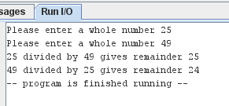
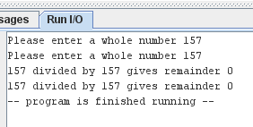
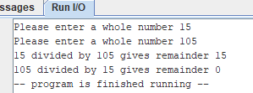
Week 5 Reinforcement Part 1
Assemble and run an existing program
Use subroutines to reduce the repeated code

Slide 4
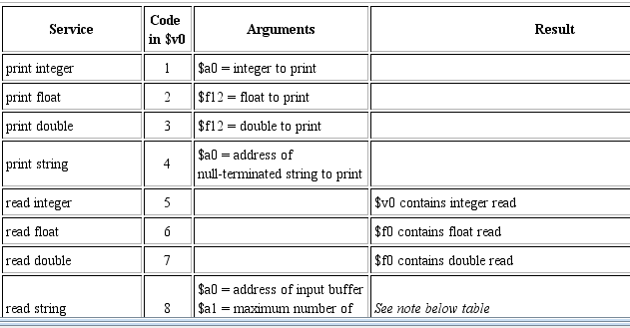
Reading input from the keyboard
In the labs we looked at output but not input
Looking at the information for syscalls

Slide 5
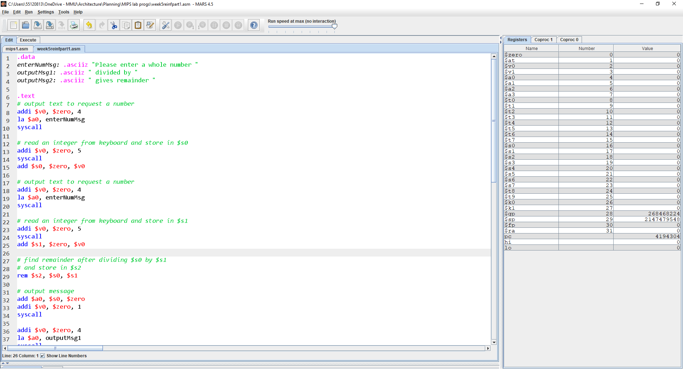
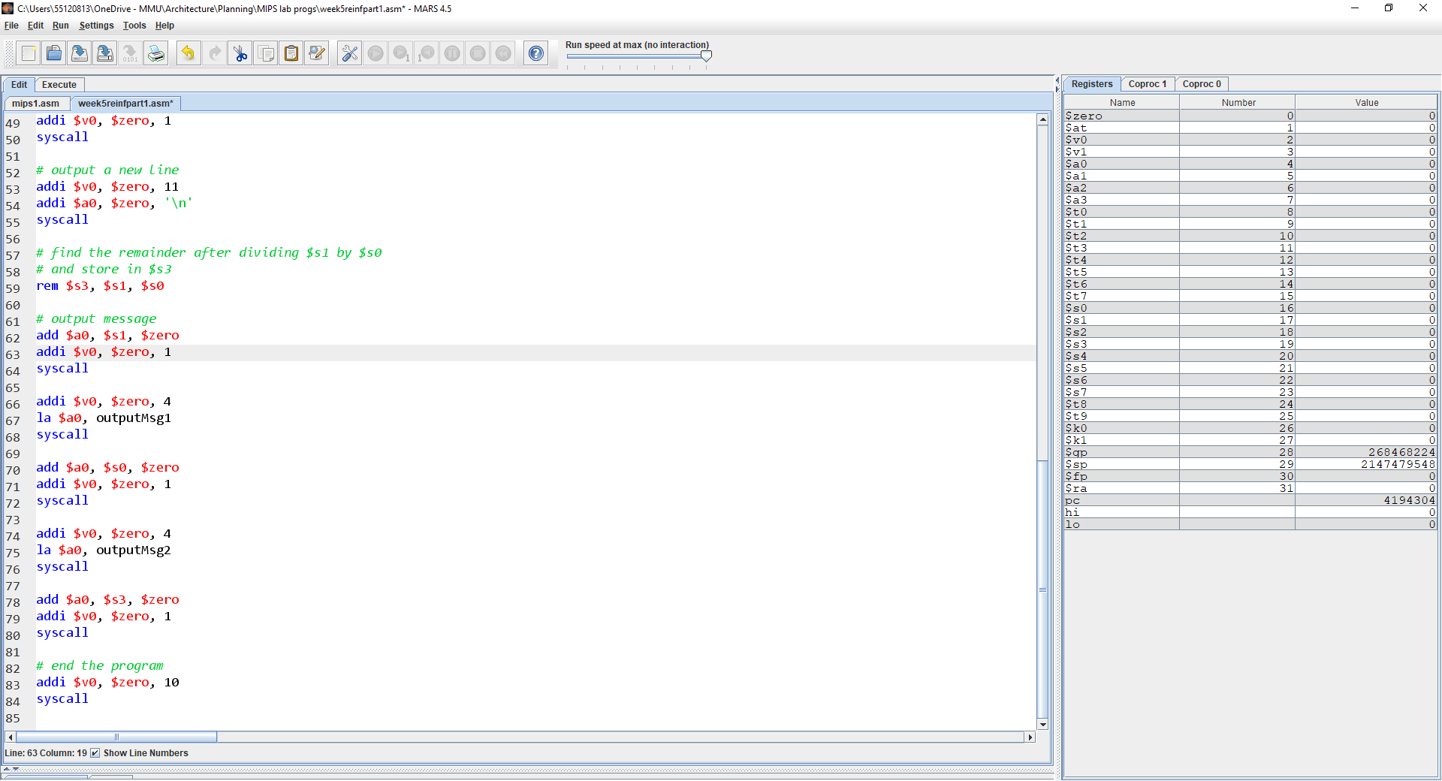
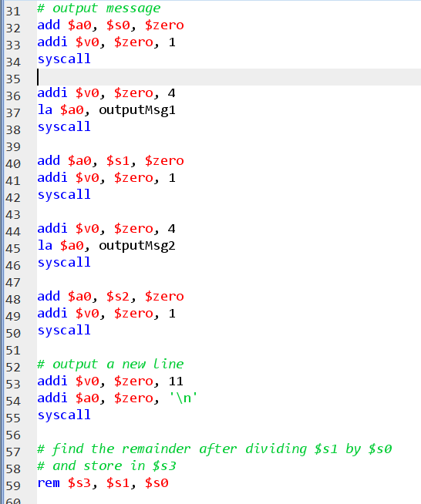
Notes:
The source code of the existing program

Slide 6
Using a subroutine
Call subroutine – jal
Program flow jumps to start of subroutine (label) and address of statement after subroutine call is stored in $ra
Return – jr $ra
Jump to address given in register $ra
End program

Slide 7
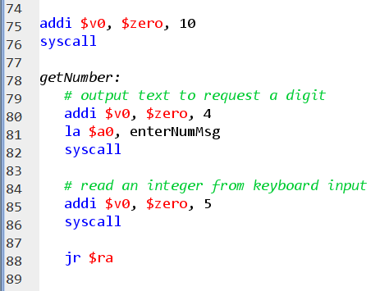
Adding a subroutine - 1

Slide 8
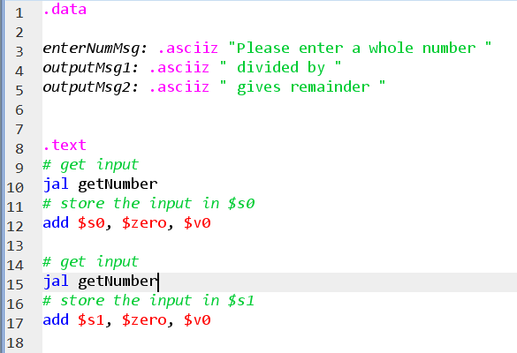
Calling the subroutine - 1
New code to get input

Slide 9
Adding a subroutine - 2
Code in later part of program is not quite the same
Can copy the values to other registers

Slide 10
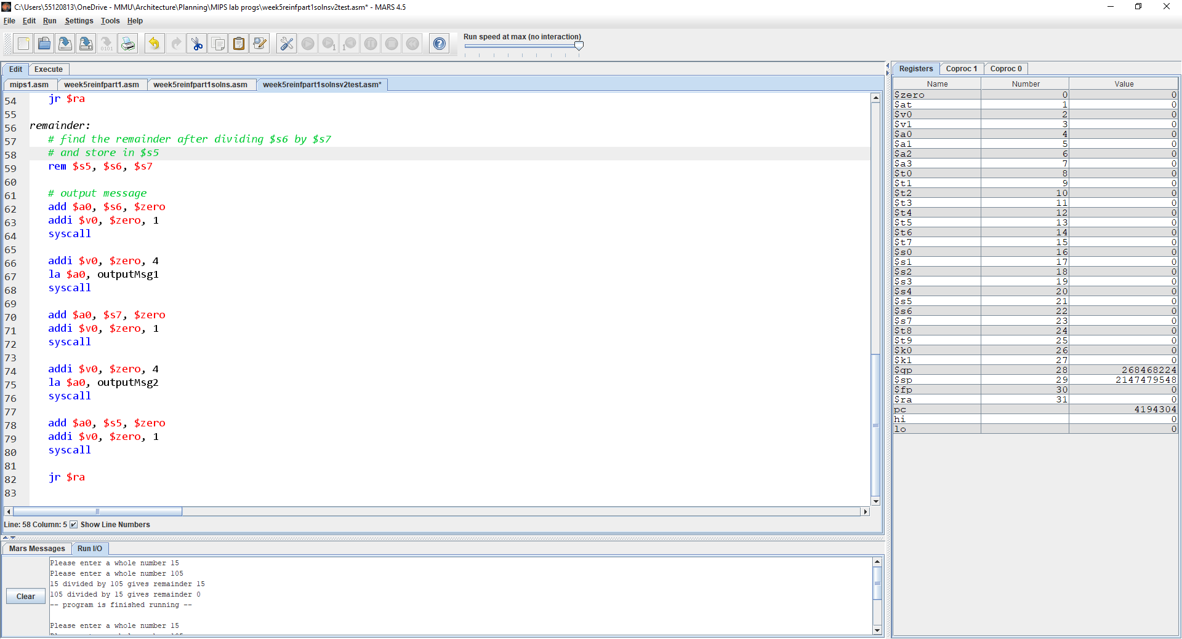
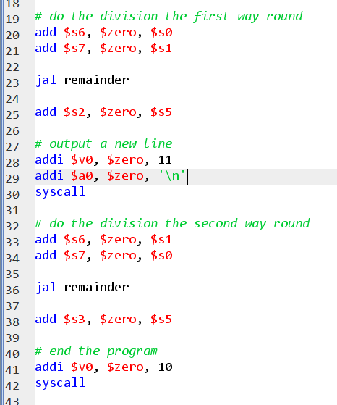

Slide 11
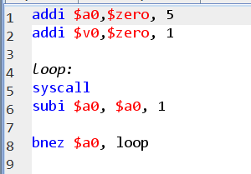
Week 5 Reinforcement Part 2
Countdown loop
Original code shown
Tasks
Ask the user for initial number to count down from
Write a space (or tab) between each digit
Use subroutine(s) where appropriate
Output:
5
4
3
2
1

Slide 12
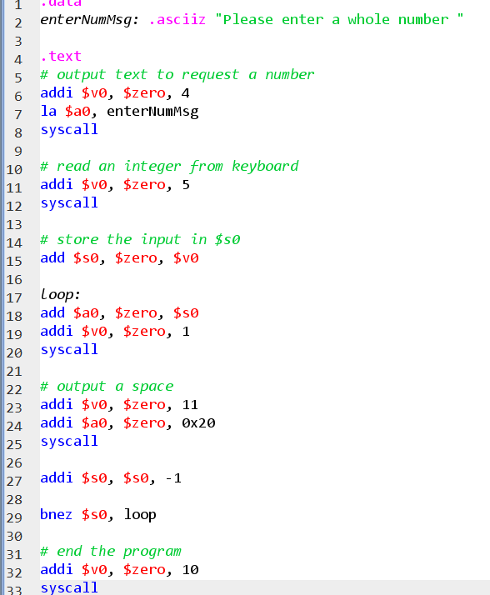
Countdown loop - improvement 1
Decisions
The register to store the input number
The initial message and spacing between the digits
With user input and formatted output
Would subroutine(s) make the code more readable?

Slide 13
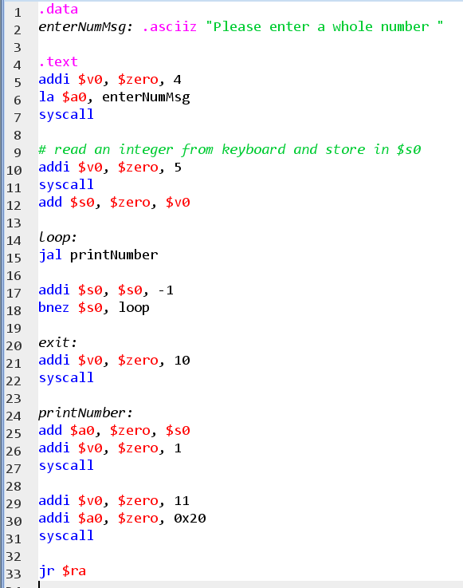
Countdown loop - improvement 2
With subroutine
Now the code in the loop should be easier to read
Note that exit is just a label but is not used in the code
I could have used a subroutine for getting a number

Slide 14
Limitations
We have used all our registers as being available globally
There are conventions for how the registers should be used and values stored in MIPS
We can only call one level of subroutine to return to our main flow of program
We can’t call a subroutine from a subroutine
We haven’t looked at arrays
This is a research task for the assessment

Slide 15
Using the stack
We have declared static memory in the .data area of the program
That usage is static because it doesn’t change while the program is running
To call subroutines from subroutines, we need dynamic memory
Dynamic memory can be allocated (and deallocated) while a program is running
The stack is one area of dynamic memory

Slide 16

Stacks
Last in first out structure (LIFO)
Place item on top of stack (push)
Top of stack moves up
Remove item from top of stack (pop)
Top of stack moves down
In MIPS you have to code the push and pop operations

Slide 17
Stack memory in MIPS architecture
The register $sp is the stack pointer
Points at the top item on the stack
The stack grows towards lower addresses
We subtract from stack pointer when we add to the stack
We add to stack pointer when we remove from the stack

Slide 18
MIPS store and load word
A word is a block of storage but varies between different architectures
In MIPS a word is 4 bytes (32 bits)
Load word
Load a register with the contents of the memory at an address held by another register, adjusted by an offset
lw $t1, -4($t2)
Store word
Store the contents from a register into memory at an address held by another register, adjusted by an offset
sw $t1, 4($t2)

Slide 19
New version of first reinforcement task
Subroutine to calculate and output the remainder still has nearly identical repeated code
I could put that in a subroutine itself
Need to store the original return address – use the stack
Subtract 4 from stack pointer, store word from $ra
Need to restore the original return address before returning from remainder subroutine
Add 4 to stack pointer, load $ra from

Slide 20
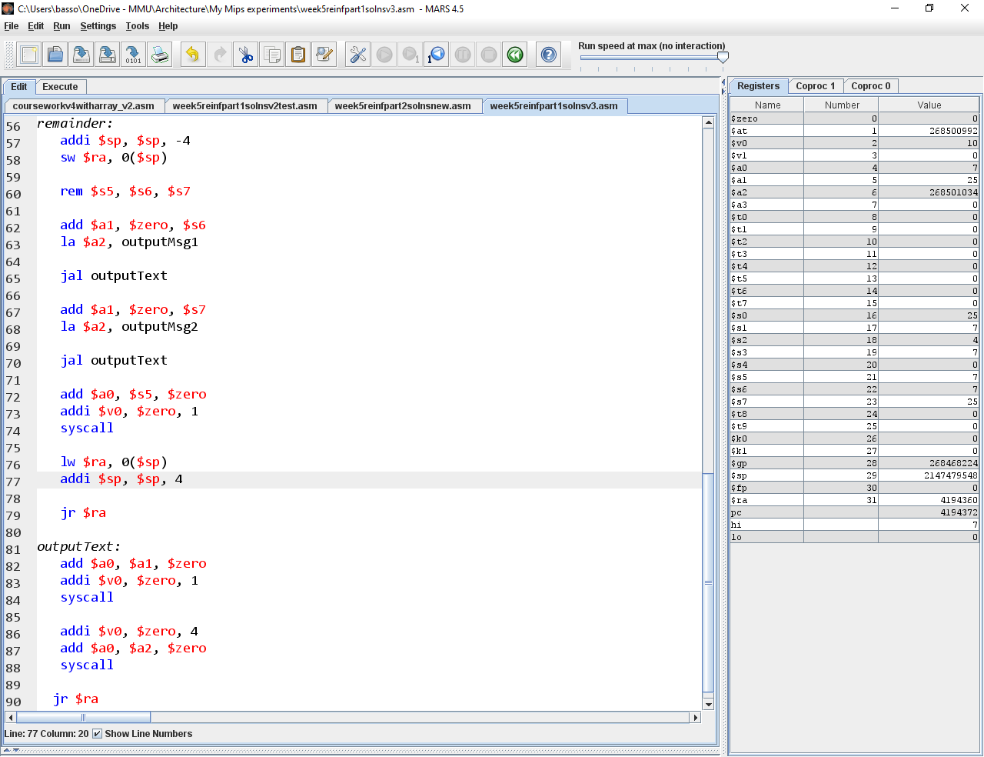
Nested subroutine
Some of the printing is separated
The original return address is saved and restored

Slide 21
Recursion
public static void main(String[] args) {
System.out.println(fact(5));
}
public static int fact(int n)
{
if (n == 0)
return 1;
return n * fact(n - 1);
}
Functions that call themselves
Factorial of a number (n) is
fact(n) = 1 * 2 * 3 * ….. * n
This is the same as
fact(n) = n * fact(n – 1)
We need a base case

Slide 22
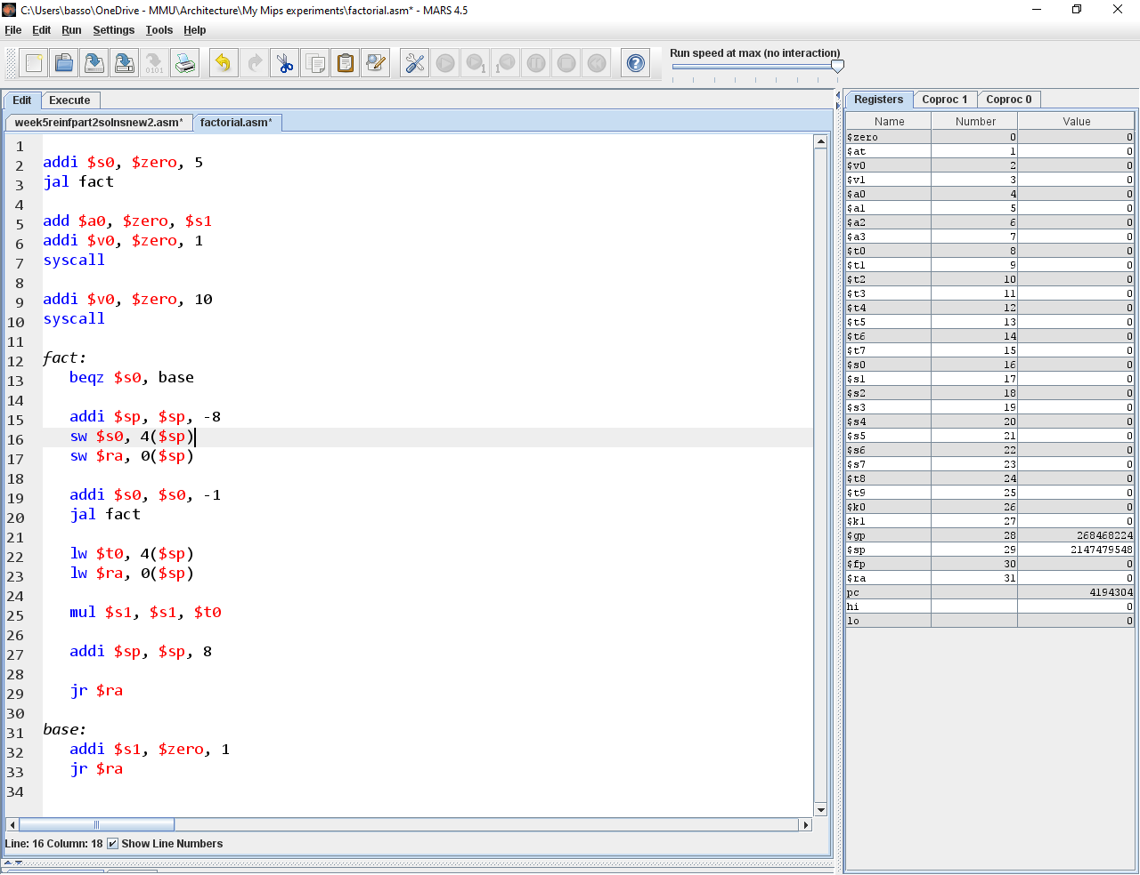
Recursion in MIPS
Keep all the relevant information on the stack
The number n ($s0)
The return address
In this example $s1 is used to store the factorial
What happens if there isn’t any room on the stack?
Address out of range
Stack overflow

Slide 23
Recursion in MIPS – the stack
Return address
1
Return address
Suppose we run the program, what will be on the stack and in $s1
2
Return address
3
Return address
4
6
2
$s1
120
0
24
1
Return address
5

Slide 24
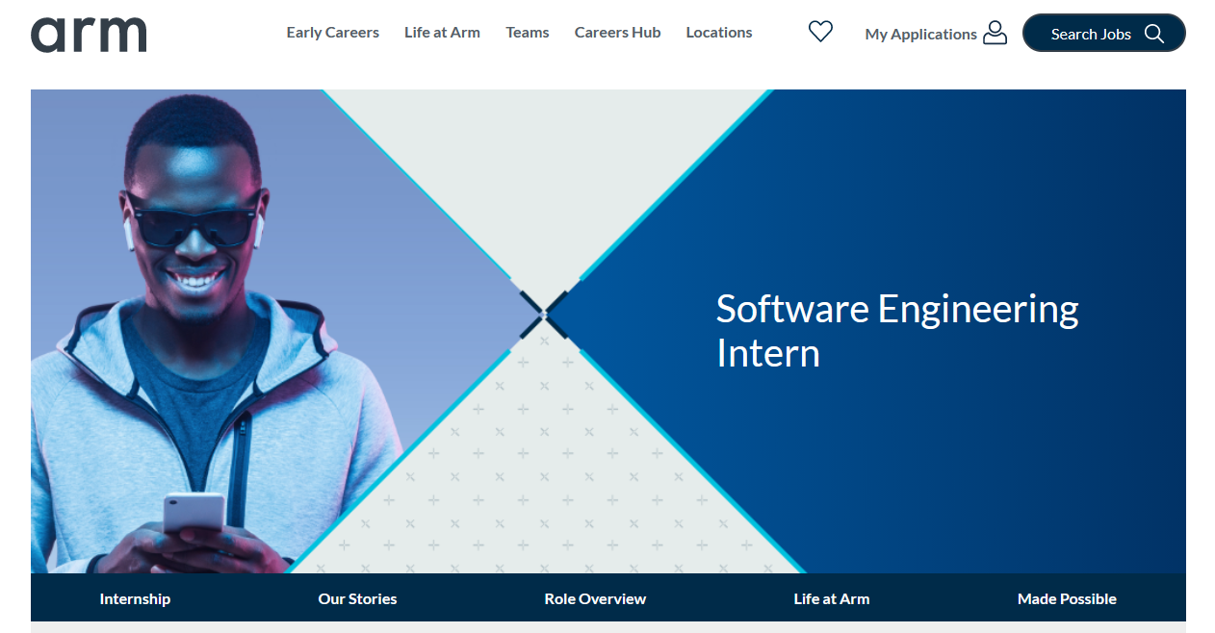
What can we do with Computer Architecture?
This unit gave an introduction to computer architecture
There are jobs and internships that expect programming experience and knowledge of computer architecture

Slide 25
Internship at arm
Skills and Experience:
Experience in at least one programming language
Motivated, independent, creative problem solver, technically versatile
An engineering approach with strong analytical and problem-solving skills
Excellent attention to detail
Good interpersonal and collaboration skills co-operating with team members around the world
Excellent written and spoken English communication, capable of writing coherent reports, influencing and building consensus
Open to new challenges and flexibility
Ability to express ideas and communicate effectively
Other qualities that will help your application stand out:
Experience in building software outside of the classroom – personal projects, hackathons, or internships.
An interest in learning more about CPUs or other hardware, and getting involved in their development

Slide 26
Summary
Thank you
Please contact the tutors for assignment support

